Slide 1
WIKIS IN EDUCATION

Slide 2
WIKIS IN EDUCATION
What is wiki?
How to use wikis?
Why use a wiki?
Examples

Slide 3
What is a wiki?
History
Ward Cunningham is the man behind the very first wiki, described it as "the simplest online database that could possibly work”
Website that allows a group of people to create and edit the website contents without any special technical knowledge or tools

Slide 4
Characteristics of Wiki
“A wiki invites all users to edit any page or to create new pages within the wiki Web site, using only a plain- vanilla Web browser without any extra add-ons.”
“Wiki promotes meaningful topic associations between different pages by making page link creation almost intuitively easy and showing whether an intended target page exists or not.”
“A wiki is not a carefully crafted site for casual visitors. Instead, it seeks to involve the visitor in an ongoing process of creation and collaboration that constantly changes the Web site landscape.” (Wiki, 2009)

Slide 5
Features of a wiki
What?
Easy to use
Can be used any time, any where
Keeps track of revision history and who has made changes
Can be set to be public or private
Is constantly under construction
Collaboration is key

Slide 6
How to Use Wikis
Start “wiki-ing”!
Choose a wiki service
Create your wiki
Use best practices

Slide 7
Choose a wiki service
Wikispace
Pbworks
wetpaint

Slide 8
Best Practices
See a sample wiki agreement at : -
http://wikicentral.wikispaces.com/file/view/mrsmaines+wiki+warranty.doc
Create a culture of trust
Set up wiki rules
Assign meaningful, authentic activities
Provide instructions and allow for practice

Slide 9
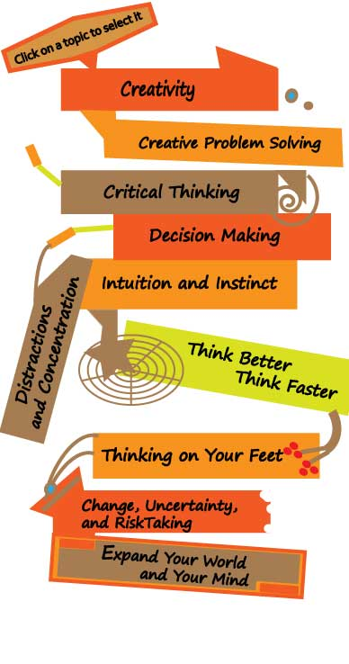
Why Use a Wiki?
◻ Allows for pedagogical strategies
◉ Cooperative learning
◉ Active learning
◉ Project-based learning
◉ Authentic instruction
◉ Inquiry
◉ Constructivism
◉ Differentiated instruction

Slide 10
Essential Skills for 21st Century Workplace
“A power shift is underway and a tough new business rule is emerging: Harness the collaboration process or perish” -Tapscott and Williams (as cited in Ferriter, 2009, p. 38)
Create
Communicate
Collaborate
Manage & evaluate online information

Slide 11
Examples
◻ Classroom Communities
◻ Global Communities
◻ Professional Communities

Slide 12
Use of Wikis in the Classroom
See Educational Wikis for classroom examples: -http://educationalwikis.wikispaces.com/Examples+of+educational+wikis
Post class information
Share resources
Whole class projects
Group-based projects
Brainstorm
Reflection/feedback/discussion
Peer or teacher writing review

